Slide 1
Sequential Circuits
时序电路

Slide 2
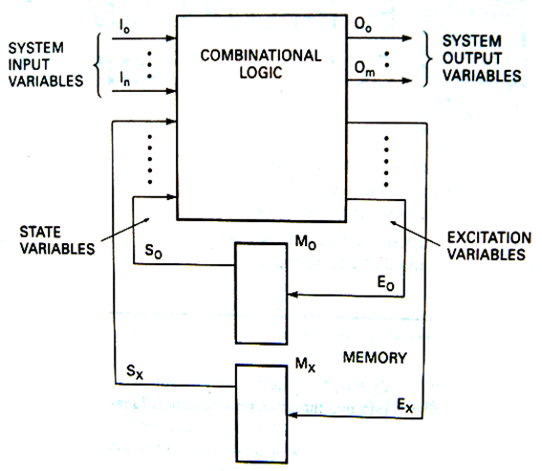
Sequential Circuit Models
输出方程
O=f₁(I,S)
激励方程
E=f₂(I,S)
状态方程
S_{t+1}=f₃(E,S_{t})
存储元件：FF

Slide 3
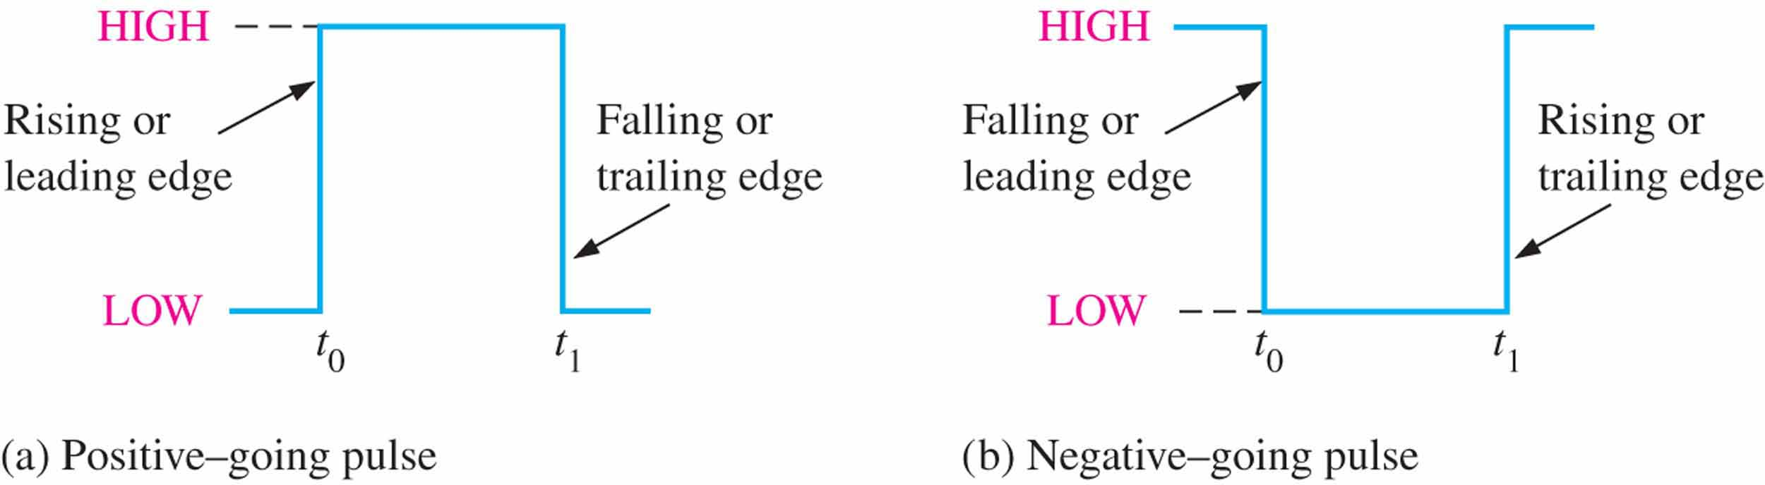
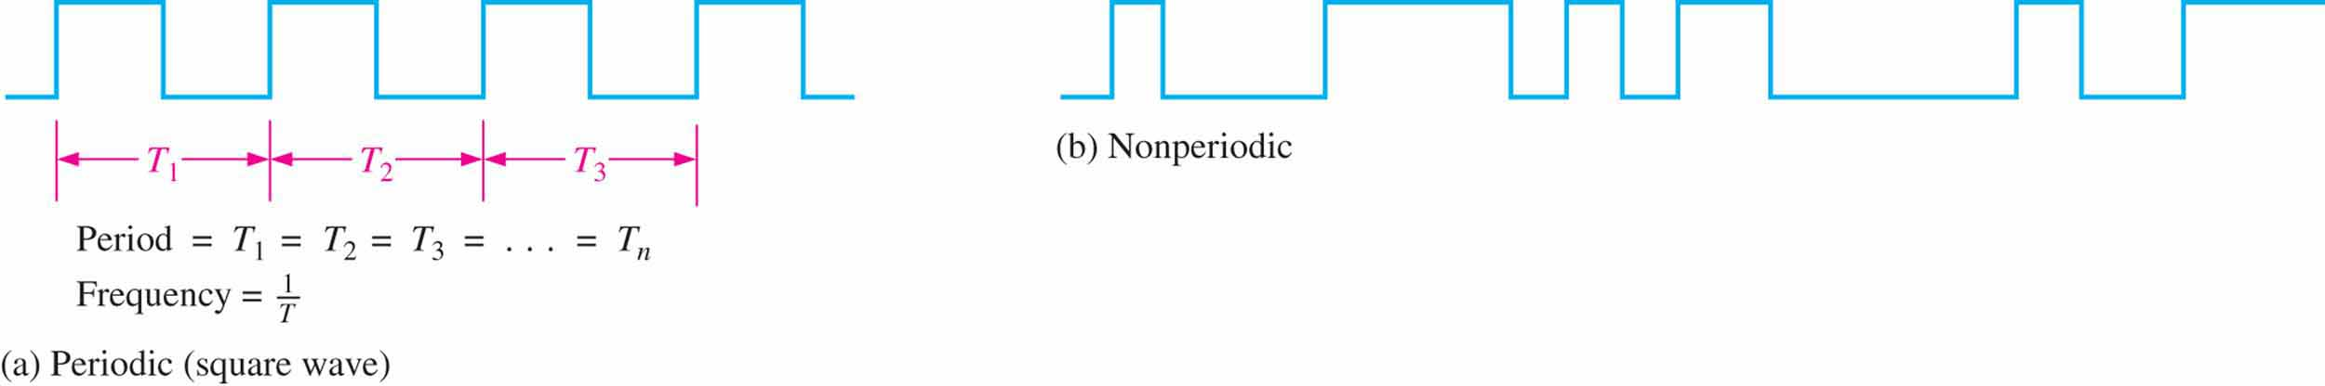
Clock signal
Clock（时钟）： the basic timing wave form. It’s a periodic waveform.

Slide 4
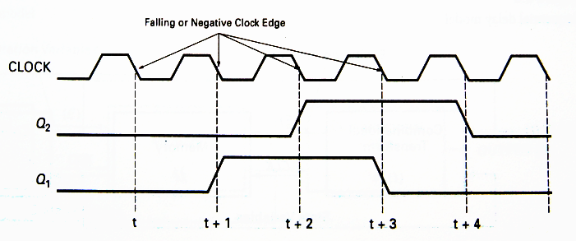
Sequential Circuit Models

Slide 5
Sequential Circuit
There are two types of sequential circuits:
Synchronous (同步) sequential circuit:
the behavior can be defined from knowledge of its signal at discrete instants of time. This type of circuits achieves synchronization by using a timing signal called the clock.
Asynchronous (异步) sequential circuit:
the behavior is dependent on the order of input signal changes over continuous time, and output can change at any time (clockless).

Slide 6
CHAPTER 7 latches, flip-flops, and timers
锁存器、触发器和定时器

Slide 7
FlipFlop / Latch 触发器/锁存器
A flipflop/latch is a temporary storage device that has two stable states (bistable). It is a basic form of memory.
Type of FF
SR
D
JK
T

Slide 8
S-R Latch S-R锁存器
The S-R (Set-Reset) latch is the most basic type. It can be constructed from NOR gates or NAND gates. With NOR gates, the latch responds to active-HIGH inputs; with NAND gates, it responds to active-LOW inputs.
NAND Active-LOW Latch
NOR Active-HIGH Latch

Slide 9
S’-R’ Latch
0
0
1
S’ | R’ | Q | Q’
0 | 0 | 1 | 1
0
1
0
1
1
0
1

Slide 10
S’-R’ Latch
0
0
1
S’ | R’ | Q | Q’
0 | 0 | 1 | 1
0 | 1 | 1 | 0
1
0
0
1
1
1
0

Slide 11
S’-R’ Latch
1
S’ | R’ | Q | Q’
0 | 0 | 1 | 1
0 | 1 | 1 | 0
1 | 0 | 0 | 1
0
0
0
1
1
1
0
0
1

Slide 12
S’-R’ Latch
S’ | R’ | Q | Q’
0 | 0 | 1 | 1
0 | 1 | 1 | 0
1 | 0 | 0 | 1
1 | 1 | NC | NC
1
0
0
1
1
NC: No Change
1
1
1
The outputs of a latch are always complements of each others.
Q=Q’ is invalid when LOWs are applied to both S’ and R’.
1
0

Slide 13
S’-R’ Latch
Present state 现态
Next state
次态
00
01
11
10
R’S’
Q^{n}
0
R’ | S’ | Q^{n} | Q^{n+1} | Comments
0 | 0 | 0 | Invalid
 |  | 1
0 | 1 | 0 | 0 | Reset (置0)
 |  | 1
1 | 0 | 0 | 1 | Set (置1)
 |  | 1
1 | 1 | 0 | 0 | Remain (保持)
 |  | 1 | 1
d
0
0
1
1
d
0
1
1
Q^{n+1}=S+R’Q^{n}
S’+R’=1 (约束)

Slide 14
S-R Latch
00
01
11
10
RS
Q^{n}
0
S | R | Q^{n} | Q^{n+1} | Comments
0 | 0 | 0 | 0 | Remain
 |  | 1 | 1
0 | 1 | 0 | 0 | Reset (置0)
 |  | 1
1 | 0 | 0 | 1 | Set (置1)
 |  | 1
0 | 1 | 0 | Invalid
 |  | 1
0
1
d
0
1
1
1
d
0
Q^{n+1}=S+R’Q^{n}
SR=0 (约束)

Slide 15
SR Latch
The active-LOW S’-R’ latch is in a stable (latched) condition when both inputs are HIGH.
To SET the latch (Q = 1), Let S’=LOW, R’=HIGH
To RESET the latch (Q = 0) , Let S’=HIGH, R’=LOW
The active-HIGH S-R latch is in a stable (latched) condition when both inputs are LOW.
To SET the latch (Q = 1), Let S=HIGH, R=LOW
To RESET the latch (Q = 0) , Let S=LOW, R=HIGH
Never apply an active set and reset at the same time (invalid).

Slide 16
SR Latch
R’
S’
Q
Q’

Slide 17
SR Latch

Slide 18
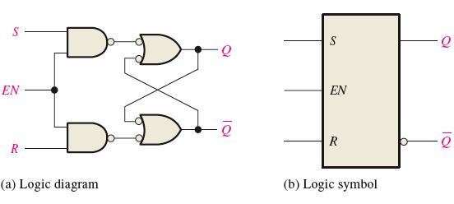
Gated S-R Latch 门控S-R锁存器
Latch is sensitive to input changes ONLY when EN=1
EN | S | R | Next state of Q
0 | X | X | No change
1 | 0 | 0 | No change
1 | 0 | 1 | Q=0; Reset state
1 | 1 | 0 | Q=1 Set state
1 | 1 | 1 | Undefined
Q^{n+1}=S+R’Q^{n}
SR=0
Characteristic Equation

Slide 19
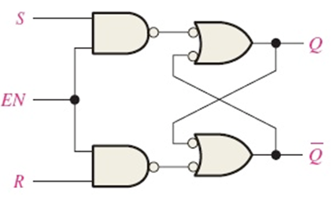
Gated S-R Latch
EN
R
S
Q
Q’
hold
hold

Slide 20
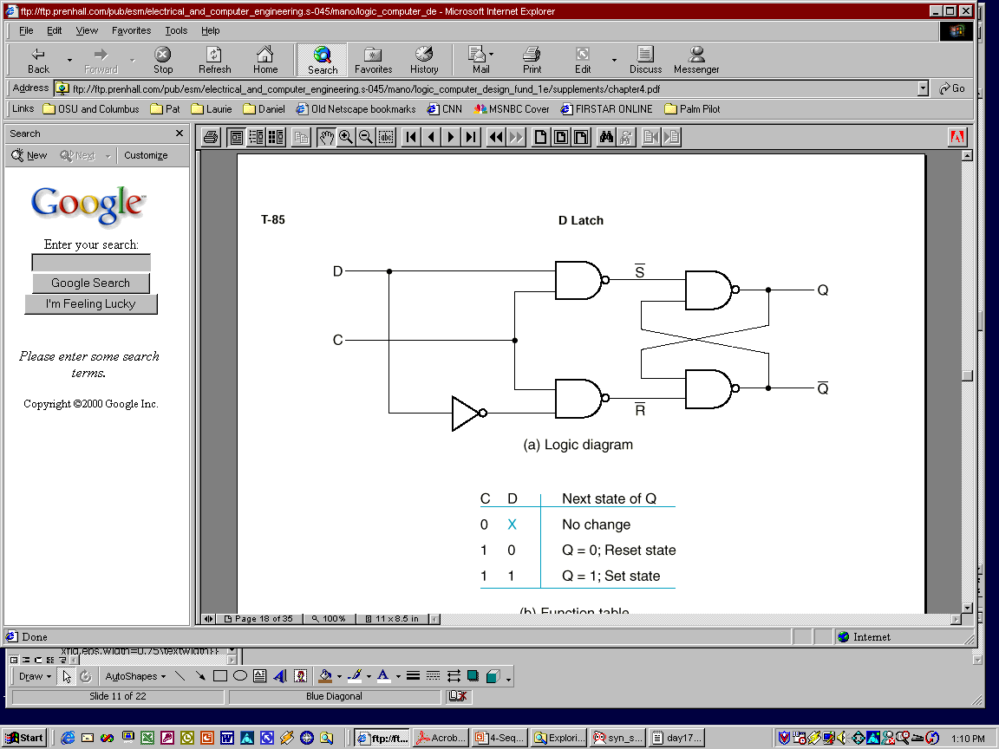
D Latch
One way to eliminate the undesirable indeterminate state in the RS flip flop is to ensure that inputs S and R are never 1 simultaneously. This is done in the D latch:
Characteristic Equation
Q^{n+1}=S+R’Q^{n}=D+D’’Q^{n}=D

Slide 21
D Latch
Determine the Q output for the D latch, given the inputs shown.
C
D
Q

Slide 22
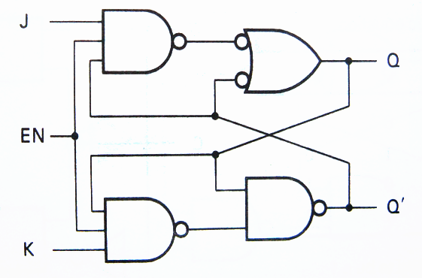
J-K Latch J-K锁存器
When EN=1
R’=(KQ^{n})’ S’=(JQ^{n}’)’
Characteristic Equation
Q^{n+1} = JQ^{n}’+K’Q^{n}
Q^{n+1} = S+R’Q^{n} = JQ^{n}’+(KQ^{n})’ Q^{n} = JQ^{n}’+K’Q^{n}
S’+R’ = (JQ^{n}’)’ + (KQ^{n})’ = J+Q^{n}+K’+Q^{n}’ = 1

Slide 23
J-K Latch
Q^{n+1} = JQ^{n}’+K’ Q^{n}
When both J and K = 1, the output changes states (toggles, 翻转).

Slide 24
J-K Latch
EN
J
K
Q
Q’

Slide 25
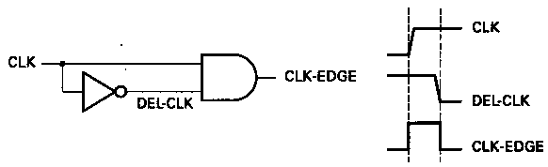
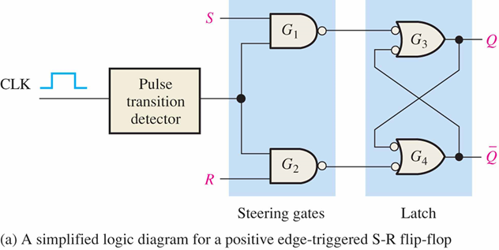
Edge triggering 边沿触发

Slide 26
Flip-flops 触发器
A flip-flop differs from a latch in the manner it changes states.
A flip-flop is a clocked device, in which only the clock edge determines when a new bit is entered.
The active edge can be positive or negative.
Positive edge-triggered
Negative edge-triggered

Slide 27
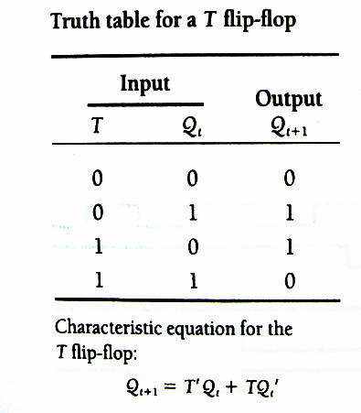
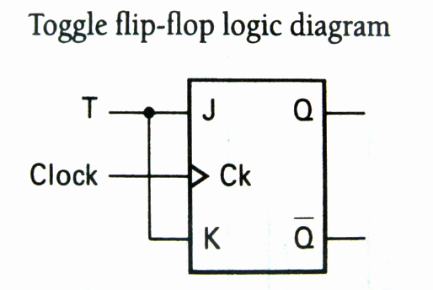
T FLIP-FLOP*
不
变
翻
转
Q^{n+1} = JQ^{n}’+K’Q^{n} = TQ^{n}’+T’Q^{n}

Slide 28
T FLIP-FLOP*
When T = 0, Q_{t+1} = Q_{t}
When T = 1, Q_{t+1} = Q_{t}’

Slide 29
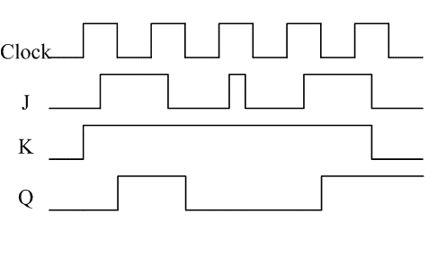
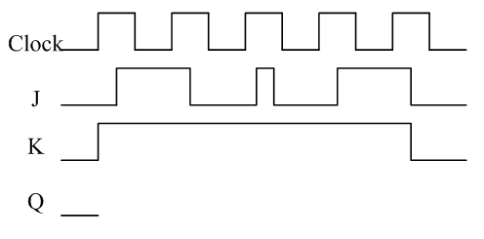
Flip-flops
E.g. Determine the Q output for the J-K flip-flop, given the inputs shown.

Slide 30
Characteristic equations compare

Slide 31
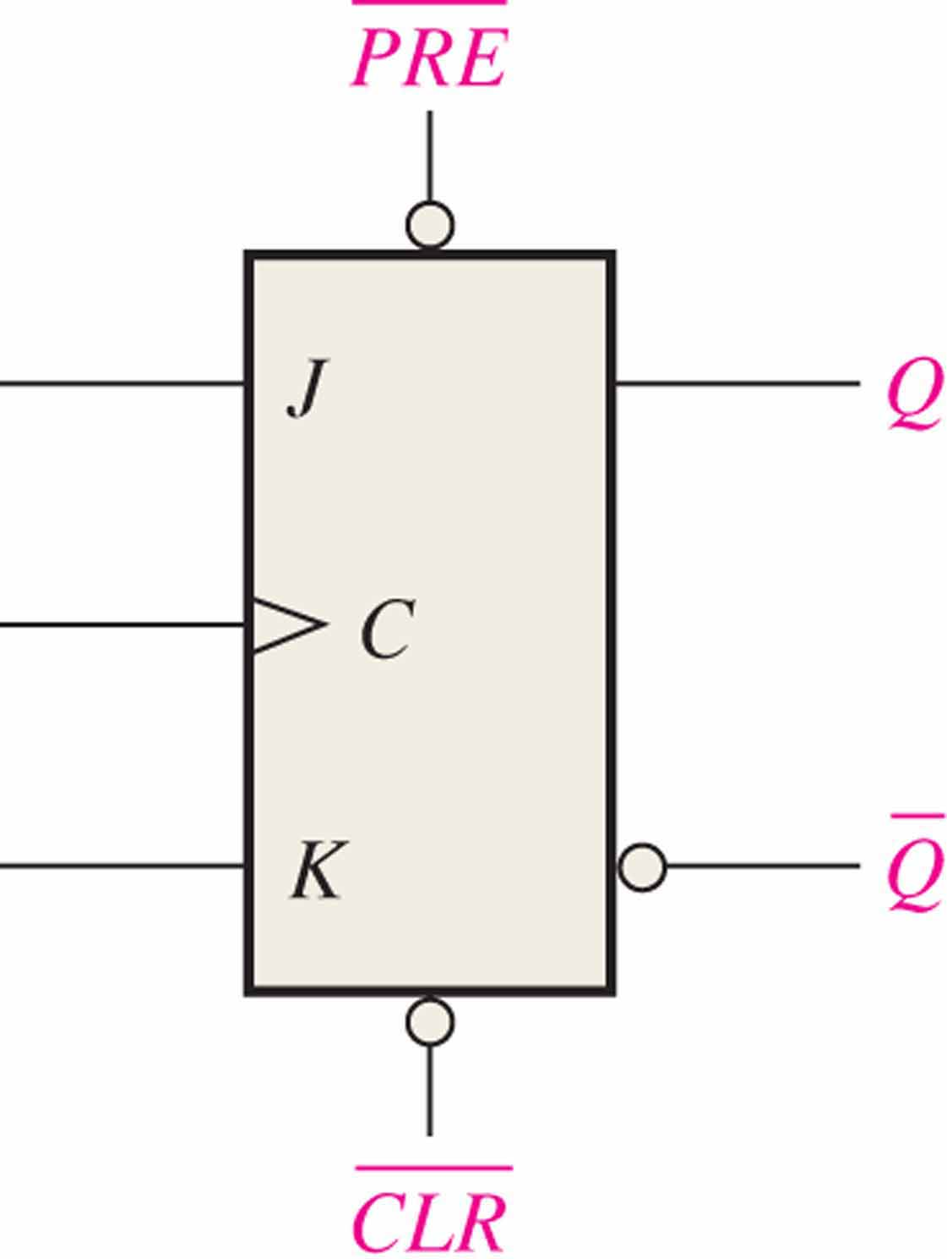
Flip-flops
Most flip-flops have other inputs that are asynchronous(异步的), meaning they affect the output independent of the clock.
Two such inputs are normally labeled preset (PRE) and clear (CLR). These inputs are usually active LOW. A J-K flip flop with active LOW preset and CLR is shown.

Slide 32
Flip-flops
PRE
Q
Example
J
Determine the Q output for the J-K flip-flop, given the inputs shown.
CLK
K
Q
Solution
Set
Toggle
Set
Reset
Toggle
Latch
CLR
CLK
J
K
Set
PRE
Reset
CLR
Q

Slide 33
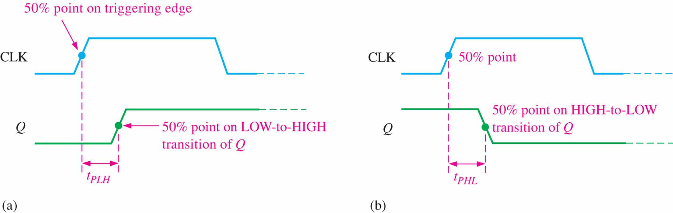
Flip-flop Characteristics* 触发器特性
Propagation delay time(传输延迟时间) is specified for the rising and falling outputs. It is measured between the 50% level of the clock to the 50% level of the output transition.

Slide 34
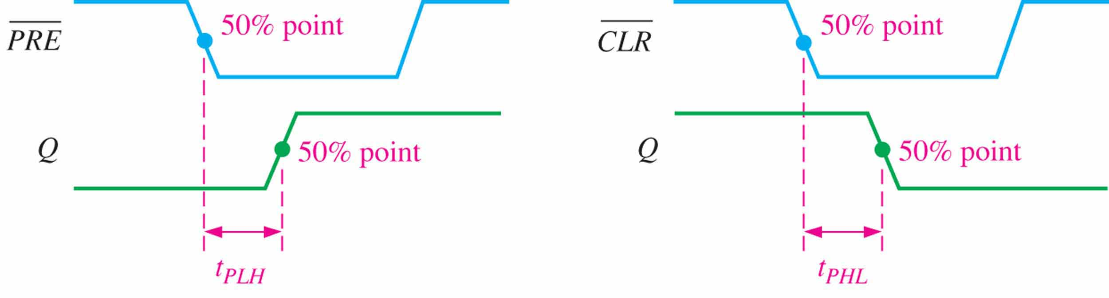
Flip-flop Characteristics*
Another propagation delay time specification is the time required for an asynchronous input to cause a change in the output. Again it is measured from the 50% levels. The 74AHC family has specified delay times under 5 ns.

Slide 35
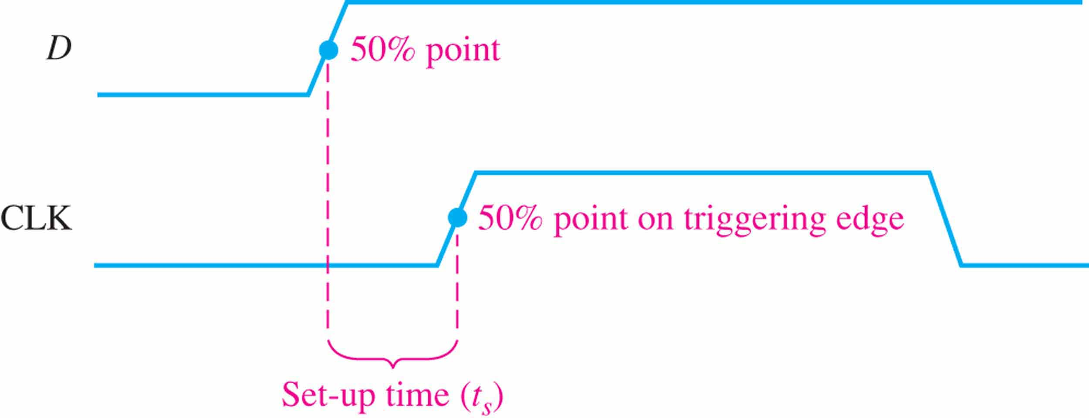
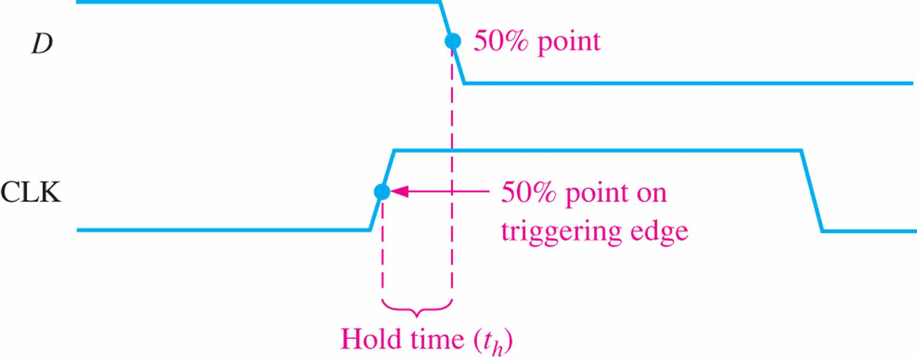
Flip-flop Characteristics*
Set-up time(建立时间) and hold time(保持时间) are times required before and after the clock transition that data must be present to be reliably clocked into the flip-flop.

Slide 36
Flip-flop Characteristics*
Other specifications include maximum clock frequency(最大时钟频率), minimum pulse widths(最小脉冲宽度) for various inputs, and power dissipation(功耗). The power dissipation is the product of the supply voltage and the average current required.
A useful comparison between logic families is the speed-power product which uses two of the specifications discussed: the average propagation delay and the average power dissipation. The unit is energy.

Slide 37
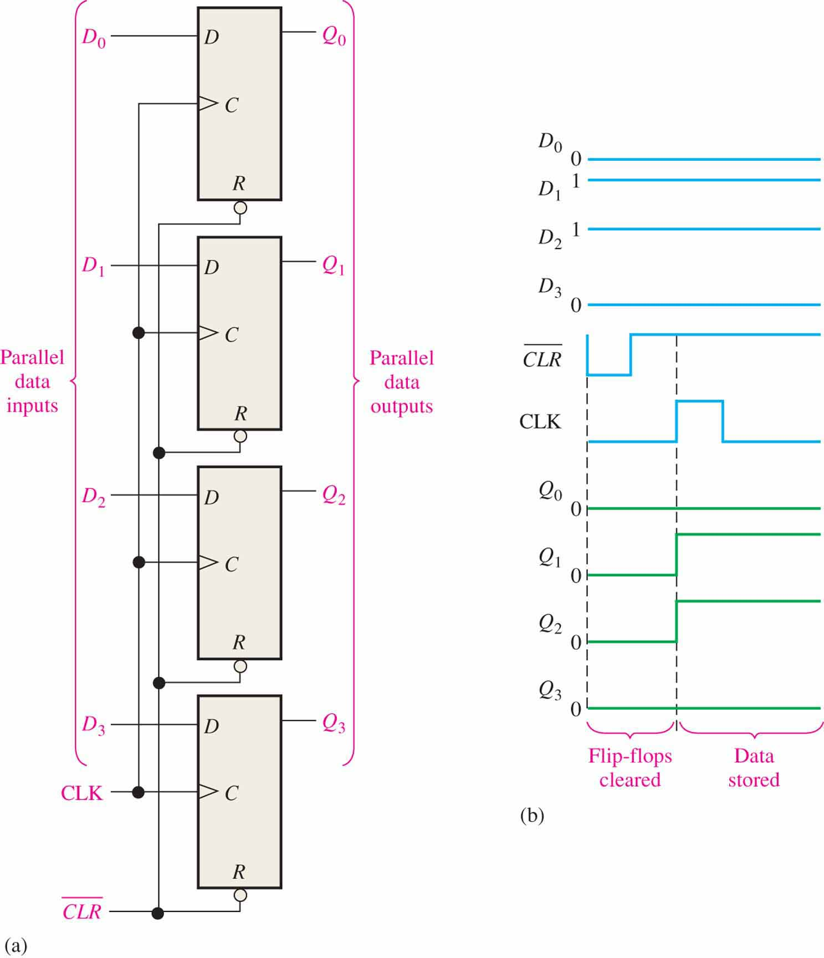
Flip-flop Applications
Principal flip-flop applications are for temporary data storage, as frequency dividers, and in counters.
Typically, for data storage applications, a group of flip-flops are connected to parallel data lines and clocked together. Data is stored until the next clock pulse.

Slide 38
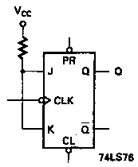
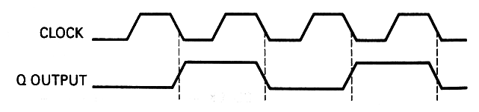
Flip-flop Applications
For frequency division(分频), it is simple to use a flip-flop in the toggle mode or to chain a series of toggle flip flops to continue to divide by two.

Slide 39
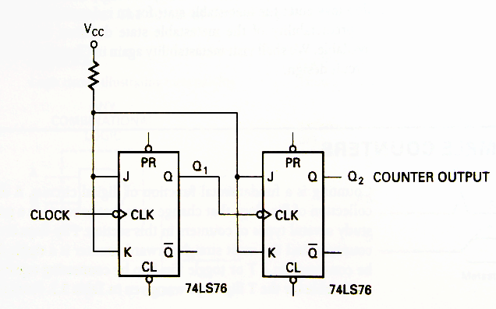
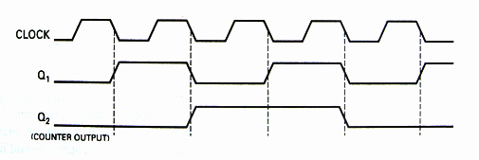
Flip-flop Applications
Devide-by-4 Counter
除4计数器

Slide 40
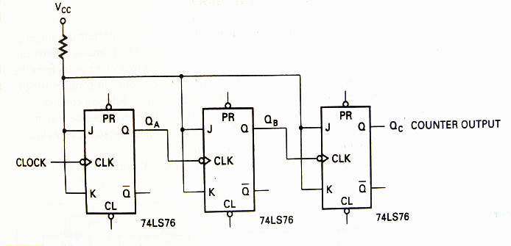
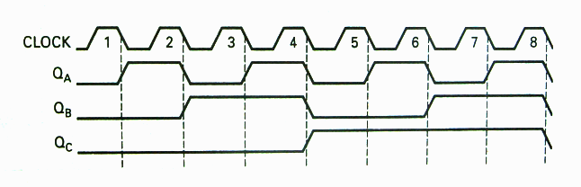
Devide-by-8 Counter
If all the output is available, it turns to a modulus-8 counter.
Devide-by- 8
Counter
除8计数器

